Slide 1
SCENE
ANALYSIS
ENG4C

Slide 2
Chosen Movie/TV Series:
Scene Analysis
Link to scene:

Slide 3
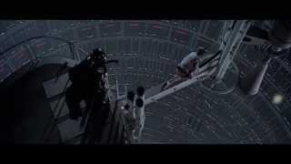
GENRE
Scene Analysis
How does the scene reflect the movie’s genre/classification? This moment underscores the epic nature of the story, as it connects the hero's journey to the larger struggle between good and evil.

Slide 4
ACTING
Scene Analysis
The acting helps sell the moment with the fights scene and the iconic “nooo!”

Slide 5
MISE-EN-SCÈNE
Scene Analysis
The atmosphere is one of tension and suspense,only really broken by the reveal

Slide 6
SOUND
Scene Analysis
The sound effects don’t really play a huge role

Slide 7
CINEMATOGRAPHY
Scene Analysis
The scene is carefully framed to emphasize power dynamics. When Vader reveals his identity, the camera often positions him towering over Luke, who is physically and emotionally vulnerable. This low-angle shot of Vader and high-angle shot of Luke visually underscore Vader's dominance and Luke's helplessness.

Slide 8
MUSIC
Scene Analysis
Is there music in this scene? How does it contribute to the scene as a whole? Its mild and helps increase the sense of scale

Slide 9
Given all of the factors identified, write a paragraph in APEC format that answers the following question: Would you define your chosen scene as great? Why or why not?
Scene Analysis
I would define the scene as great thanks to the unique visuals the great fight choreography and the interesting twist The scene's unique visuals are evident in the contrast between light and dark, the colder more muted colors,emphasizing the tension and emotional importance of the moment. The fight choreography is well done,blending physical intensity with emotional stakes, as seen in the dynamic lightsaber duel that transitions seamlessly into the climactic revelation.
When combined the visuals choreography and voice acting combine to make a truly iconic scene

